Slide 1
HOSPITAL
Submitted By:
RAJA HUMZA NAWAZ
SYED MUHAMMAD SHOAIB SHAH
HARIS ZAHID

Slide 2
HOSPITAL:
An institution providing medical and surgical treatment and nursing care for sick or injured people.
There are two common abbreviations of hospital: hosp. and H. If you want to make hosp. plural, simply add on an “s.” The second abbreviation cannot be pluralized and is generally seen on signage.

Slide 3
History and Etymology for Hospital:
Middle English hospital, ospitale "residence for pilgrims and travelers, charitable institution providing residence for the poor and infirm," borrowed from Anglo-French, borrowed from Medieval Latin hospitāle, going back to Latin, in plural hospitālia "guest accommodations" (probably by ellipsis from hospitāle cubiculum "sleeping room for guests"), noun derivative from neuter of hospitālis "of a guest, of hospitality, hospitable," from hospit-, hospes "guest, host" + -ālis -AL entry 1 — more at HOST entry 3

Slide 4
Classification Of Hospital:
Hospitals are classified as,
General
Specialty
Government

Slide 5
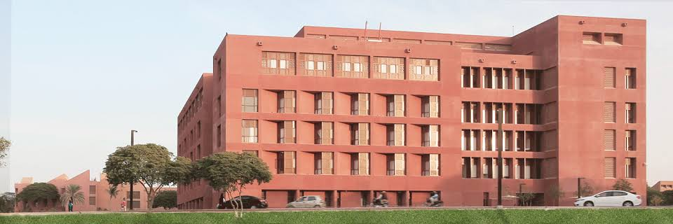
General Hospital:
The best-known type of hospital is the general hospital, which typically has an emergency department to treat urgent health problems ranging from fire and accident victims to a sudden illness. A district hospital typically is the major health care facility in its region, with many beds for intensive care and additional beds for patients who need long-term care.

Slide 6
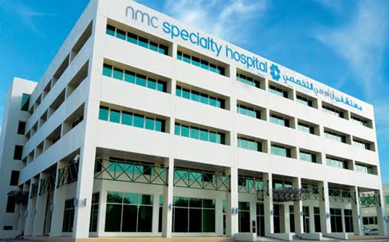
Specialty Hospital:
Specialized hospitals include trauma centers, rehabilitation hospitals, children's hospitals, seniors' (geriatric) hospitals, and hospitals for dealing with specific medical needs such as psychiatric treatment (see psychiatric hospital) and certain disease categories. Specialized hospitals can help reduce health care costs compared to general hospitals.

Slide 7
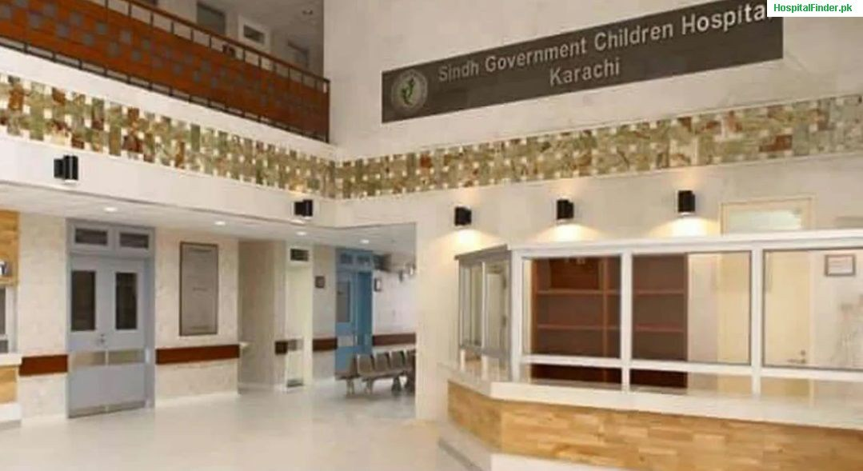
Government Hospital:
A public hospital, or government hospital, is a hospital which is owned by a government and receives government funding. In some countries, this type of hospital provides medical care free of charge to patients, covering expenses and wages by government reimbursement.

Slide 8
DEPARTMENTS:
Some hospitals have outpatient departments and some have chronic treatment units. Common support units includes,
Pharmacy
Pathology
Radiology.

Slide 9
EQUIPMENTS NEED IN HOSPITALS:
10 Pieces of Medical Equipment All Hospitals Need.
1. Hospital Stretchers
Transporting patients is very important when dealing with emergencies. This piece of equipment is an absolute must-have for hospitals to keep on hand as patients route through their care.
2. Defibrillators
Commonly used in life-threatening situations such as cardiac arrhythmias or tachycardia, defibrillators restore normal rhythm to the heart. They’re essential tools that a hospital always needs backups for.
3. Anesthesia Machines
Anesthesia machines are designed to provide an accurate and continuous supply of medical gases to maintain a proper level of anesthesia to a patient. Modern anesthesia machines include added tools such as a ventilator, suction unit, and patient-monitoring devices.
4. Patient Monitors
Patient monitors are standard pieces of medical equipment that keep accurate track of a patient’s condition and state of health during and after surgery. They are necessary for adult, pediatric & neonatal patients.
5. Sterilizers
Hospital sterilizers kill all forms of microbial life including fungi, bacteria, viruses, spores, and all other entities present on surgical tools and other medical items. An autoclave sterilizes equipment and supplies using high-pressure saturated steam for a short period of time.

Slide 10
6. EKG/ECG Machines
Electrocardiogram (EKG) machines record the electrical activity of the heart over a period of time and allow health care providers to monitor the overall rhythm of the heart and identify any abnormalities.
7. Surgical Tables
Surgical tables are necessities for a hospital. For patient preparation, surgical procedures and recovery, these pieces of equipment are essential.
8. Blanket and Fluid Warmers
Body temperatures that are not maintained during surgery can lead to post-surgical complications such as perioperative hypothermia, prolonged hospitalization and recovery, and an increase in the risk for infection. That’s why blanket warmers and fluid warmers are so essential for hospitals to have.
9. Electrosurgical Units
An electrosurgical unit is used in surgery to cut, coagulate, or otherwise alter tissue, often to limit the amount of blood flow to an area and increase visibility during a surgery. This equipment is crucial to cauterizing and minimizing blood loss during surgery.
10. Surgical Lights
Surgical lights are a mandatory part of any surgical setting to help surgeons work under adequate lighting conditions.

Slide 11
Some More Useful Equipment:
Defibrillators, patient monitors, surgical tables, EKGs, anesthesia machines, sterilizers, lights, ultrasounds, and electrosurgical units, blanket/fluid warmers are all necessary pieces hospital equipment. Keeping these on hand are critical to the operational success of a hospital and the health care provided within it.

Slide 12
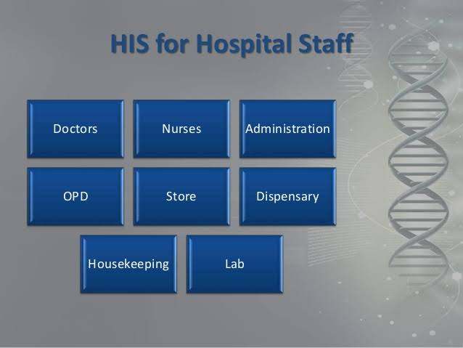
HOSPITAL STAFF:
There are many people who contribute to your care while you are in hospital. Numerous people and services work together to provide you with successful treatment in a hospital, from medical assessments and daily treatment to medication and catering. The key roles for staff in a hospital can be broadly categorized into four areas being:
doctors (medical staff)
nurses
allied health professionals
support staff.
All these people will play an important role in your treatment and recovery.

Slide 13
Doctors – roles and responsibilities:
Doctors have different roles and responsibilities based on their level of experience and their medical specialty. These roles include:
senior consultants – specialist doctors who see patients at specific times
registrars – senior doctors who supervise residents, interns and students
residents – look after patients on the ward and are in training for specialization
interns – have completed their studies and are now finishing their final year in hospital
student doctors – undergraduate medical students.
The resident is based on the ward and is typically the doctor you will see most often. The registrar is the ward’s senior doctor and is usually contactable on site, while the senior consultant (or specialist) attends ward rounds and meetings at specific times.

Slide 14
Nurses – roles and responsibilities
Like doctors, nurses have different roles and responsibilities based on their experience and specialties. These roles include:
nurse unit manager – runs the ward
associate nurse unit manager – helps the nurse unit manager to run the ward and acts as the manager when the nurse unit manager is off site
nurse practitioners – highly skilled nurses with an advanced level of training
specialist nurses, such as clinical nurse specialists, clinical nurse consultants, clinical nurse educators, triage nurses, emergency department nurses
registered nurses – provide a high level of day-to-day care and perform some minor procedures
enrolled nurses – provide basic medical care under the supervision of more senior nurses.

Slide 15
Other hospital staff:
Keeping a hospital running requires a great deal of organisation and administration. During your hospital stay, you will see a wide range of support and administrative staff taking care of everything from laundry and meals to patient transport and maintenance. Hospital support staff you may meet during your stay include:
clinical assistants – take care of ward housekeeping
patient services assistants – bring meals and drinks
porters – take care of patient lifting and transport
volunteers – help with fundraising and ward visits
ward clerks – staff the ward reception desks.

Slide 16
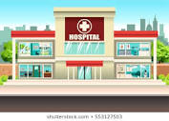
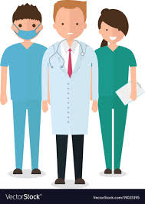
CONCLUSION:
Each member of the hospital has a role to play in the prevention of hospital-acquired infections. The greatest responsibility lies with the healthcare professionals, particularly nurses and doctors, who in the hospital setting are in contact with patients and their families 24 hours a day, and because of this are the main perpetrators of cross- infection. However, they can also demonstrate good practice by, for example, being the catalysts for change, and improving the education of other hospital staff and families.

